Slide 1

Chapter 5
Prepared By : Sheetal J. Nagar,
Atmiya Institute of Technology & Science, Rajkot.

Slide 2
Basic Memory Management
Most computers have a memory hierarchy, with a small amount of very fast, expensive, volatile cache memory, volatile main memory(RAM) and non volatile disk storage.
It is the job of operating system to coordinate how these memories are used.
“The part of the operating system that manages memory hierarchy is called the memory manager”.

Slide 3
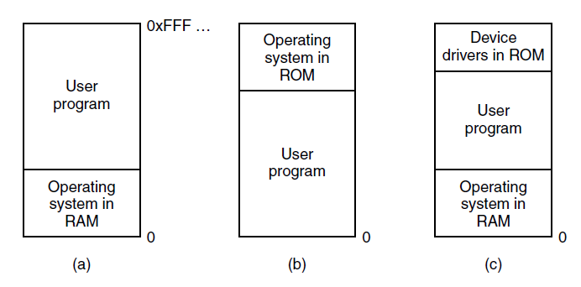
1)Monoprogramming without swapping or paging
Figure: Three simple ways of organizing memory with an operating system and one user process.

Slide 4
There is no Memory Abstraction
The simple possible memory management scheme is to run just one program at a time, sharing the memory between that program and Operating System.
(a) Used in early mainframe and minicomputer
(b) Some palmtop and embedded system
(c) Early PC (running MS-DOS)

Slide 5
2)Multiprogramming with Fixed Partition
  Memory is divided into n fixed sized partitions.
  Size can be different for all the partitions.
  Each partition can hold exactly one process.
  The partition boundaries are not movable.
  Whenever a process arrives it is put into the queue of the smallest partition large enough to hold it.
  If the partition of the required size is free, the process is put into that partition, else the process needs to wait in the queue of that partition.
  Since partitions are fixed in this scheme, any space in a partition can not be used by another process. Thus, it is wasted.

Slide 6
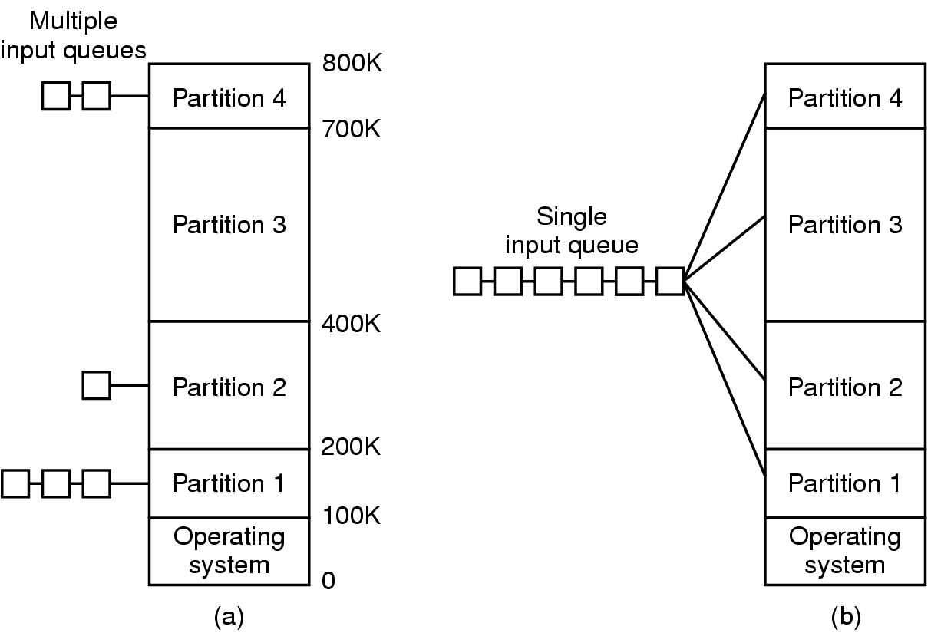
  There are two ways to maintain queue
    Multiple Input Queues.
    Single Input Queue.

Slide 7
Multiple Input Queues.
Separate Queue for each partition is used.
Disadvantage :
If the queue for a large partition is empty but the queue for a small partition is full, then small jobs have to wait to get into memory, even though plenty of memory is free.

Slide 8
Single Input Queue
  Here single queue is used for all the partitions.
  Whenever a partition becomes free, the job closest to the front of the queue that fits in it could be loaded into the empty partition and run.
  Since it is undesirable to waste a large partition on small job, a different strategy can be used.
  This strategy says to “search the whole input queue and pick up the largest job.”
  This strategy is against the small jobs and usually it is desirable to give the best service to the smallest jobs.

Slide 9
Solution 1:
One way to solve this is to have at least one small partition around. Such a partition will allow small jobs to run without having to allocate a large partition for it.
Solution 2:
Another solution is to have a rule that ‘a job that is eligible to run MAY NOT BE SKIPPED OVER MORE THAN K TIMES’.
Each time a job will be skipped, it will get one point, when it will acquires k points, it will not be skipped again.

Slide 10
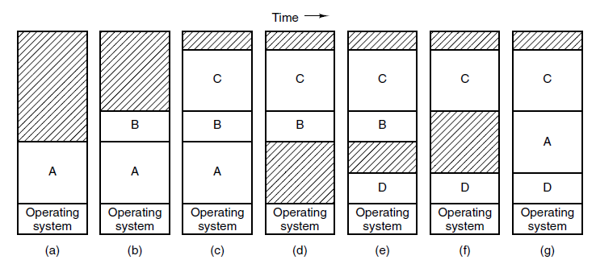
3)Multiprogramming with Variable Partition
Figure: Memory allocation changes as processes come into memory and leave it. The shaded regions are unused memory

Slide 11
  Memory is not divided into any fixed partitions.
  Also the number of partitions is not fixed.
  Process is allocated exactly as much memory as it requires.
  Whenever any process enters in a system, a portion of free memory big enough to fit the process is found and allocated.
  Sometimes there is not enough memory to hold all the processes, so the processes that cannot be placed in memory are kept on disk.

Slide 12
  Swapping :
  “The simplest strategy called swapping consists of ‘bringing in’ each process in memory (in its entirety), running for a while then ‘putting it back’ on the disk.”
  Memory compaction :
“When swapping creates multiple holes in memory, it is possible to combine them all into one big hole by moving all the processes downward as far as possible, This technique is known as memory compaction”

Slide 13
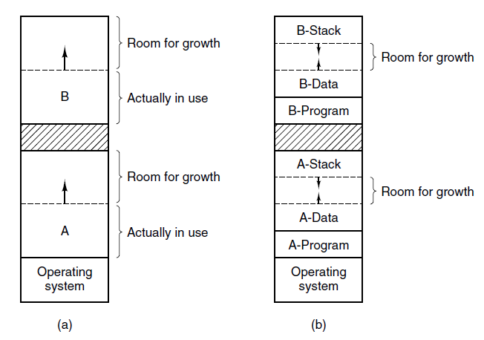
Allocating Space
Figure: (a) Allocating space for a growing data segment.
(b) Allocating space for a growing stack and a growing data segment.

Slide 14
If it is expected that most processes will grow as they run, it is probably a good idea to allocate a little extra memory whenever a process is swapped in or moved (to reduce the overhead associated with moving or swapping processes that no longer fit in their allocated memory).
However, when swapping processes to disk, only the memory actually in use should be swapped.

Slide 15
In Fig. (a) space for growth has been allocated to two processes If processes can have two growing segments
In Fig. (b) each process has a stack at the top of its allocated memory that is growing downward, and a data segment just beyond the program text that is growing upward.
Data segment - is used as a heap for variables that are dynamically allocated and released
Stack segment – is used for the normal local variables and return addresses.
The memory between them can be used for either segment.

Slide 16
Memory management with
Bit maps
and
Linked list

Slide 17
  When memory is assigned dynamically, the operating system must manage it.
  2 ways to keep track of memory usage.
    Memory Management with Bitmap.
    Memory Management with Linked List.

Slide 18
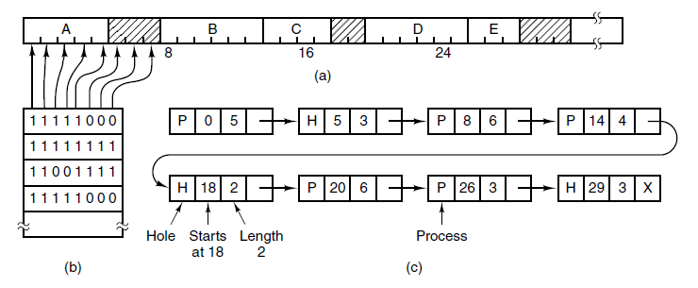
Memory Management with Bitmaps and Linked Lists
Figure : (a) A part of memory with five processes and three holes. The shaded regions (0 in the bitmap) are free.
(b) The corresponding bitmap.
(c) The same information as a list.

Slide 19
1) Memory Management with Bitmaps
Figure : (a) A part of memory with five processes and three holes. The shaded regions (0 in the bitmap) are free.
(b) The corresponding bitmap.

Slide 20
With bitmap, memory is divided into allocation units.
Corresponding to each allocation unit there is a bit in a bitmap.
Bit is 0 if the unit is free.
Bit is 1 if unit is occupied.
The size of allocation unit is an important design issue, the smaller the size, the larger the bitmap.
The main problem is that when it has been decided to bring a k unit process, the memory manager must search the bitmap to find
k consecutive 0 bits in the map.
Searching a bitmap for a given length is a slow operation

Slide 21
2) Memory Management with Linked Lists
(c) The same information as a list.

Slide 22
Another way to keep track of memory is to maintain a linked list of allocated and free memory segments.
where segment either contains a process or is an empty hole between two processes.
The memory of (a) is represented in (c) as a linked list of segments.
Each entry in the list specifies a hole (H) or process (P), the address at which it starts the length and a pointer to the next entry.

Slide 23
The segment list is kept sorted by address.
Sorting this way has the advantage that when a process terminates or is swapped out, updating the list is straightforward.
A terminating process normally has two neighbors, These may be either processes or holes, leading to the four combinations as shown in the figure of next slide.

Slide 24
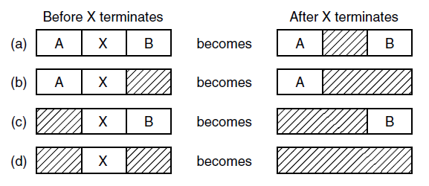
Fig. - 4 neighbor combinations for the terminating process, X.
In Fig. (a) updating the list requires replacing a P by an H.
In Fig. (b) and (c) two entries are merged into one, and the list becomes one entry shorter.
In Fig. (d), three entries are merged and two items are removed from the list.

Slide 25
Memory Management
Algorithms

Slide 26
Memory Management Algorithms
First fit
Next fit
Best fit
Worst fit
Quick fit

Slide 27
1) First fit
It is the simplest algorithm..
The memory manager scans along the list of segments until it finds a hole that is big enough.
The hole is then broken up into two pieces, one for the process and one for the unused
memory ( except in the case of an exact fit).
First fit is a fast algorithm because it searches as little as possible.

Slide 28
2) Next fit
A minor variation of first fit is next fit. It works the same way as first fit, except that it keeps track of where it is whenever it finds a suitable hole.
The next time it is called to find a hole, it starts searching the list from the place where it left off last time, instead of always at the beginning, as first fit does.
Simulations show that next fit gives slightly worse performance than first fit.

Slide 29
3) Best fit
It is well-known and widely used algorithm.
It searches the entire list, from beginning to end, and takes the smallest hole that is sufficient.
Rather than breaking up a big hole that might be needed later, best fit tries to find a hole that is close to the actual size needed
Best fit is slower than first fit because it must search the entire list every time it is called.
Somewhat surprisingly, it also results in more wasted memory than first fit or next fit because it tends to fill up memory with tiny, useless holes.

Slide 30
4) Worst fit
Best fit tends to fill up memory with tiny, useless holes.
First fit generates larger holes on the average.
Let’s go for Worst Fit.
Worst Fit always take the largest hole, so that the new hole will be big enough to be useful.
Simulation has shown that worst fit is not a very good idea either.

Slide 31
5) Quick fit
quick fit maintains separate lists for some of the more common sizes requested.
For example, it might have a table with n entries, in which the
  1st entry is a pointer to the head of a list of 4-KB holes,
  2nd entry is a pointer to a list of 8-KB holes
  3rd entry a pointer to 12-KB holes, and so on.
  Holes of, say, 21 KB, could be put either on the 20-KB list or on a special list of odd-sized holes

Slide 32
Pointer to 4KB Holes
Pointer to 8KB Holes
Pointer to 12KB Holes
Pointer to 16KB Holes
Pointer to 20KB Holes

Slide 33
Advantage:
With quick fit, finding a hole of the required size is extremely fast
Disadvantage:
It has the same disadvantage as all schemes that sort by hole size, namely, when a process terminates or is swapped out, ‘finding its neighbors to see if a merge with them is possible’ is quite expensive.

Slide 34
Virtual Memory

Slide 35
Virtual Memory
There is a need to run programs that are too large to fit in memory. Solution usually adopted is, to split programs into little pieces, called overlays.
To split up the large program into small pieces, a method is developed which is known as virtual memory.
The basic idea behind virtual memory is that, the combined size of program, data and stack may exceed the amount of physical memory available for it.
  The operating system keeps those parts of the program currently in use in main memory, and the rest on the disk.

Slide 36
  These pages are mapped onto the physical memory but, to run the program, all pages are not required to be present in the physical memory.

Slide 37
Paging
Virtual Addresses : The program generated address is called as Virtual Addresses.
Virtual Address Space : Virtual Addresses form the Virtual Address Space.
Paging : Most virtual memory system uses a technique called paging.
Pages : Virtual address space is divided into Fixed-size units called pages.
Page Frame : The physical memory is divided into Fixed-size units called page frames.
NOTE : The pages and page frames are always of the same size.

Slide 38
Paging
Size of Virtual Address Space is greater than that of Main memory, so instead of loading entire address space in to memory to run the process, MMU copies only required pages into main memory.
“In order to keep the track of pages and page frames, OS maintains a data structure called page table”.

Slide 39
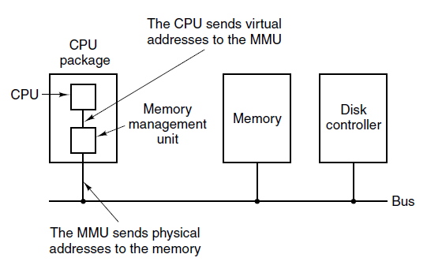
MMU (Memory Management Unit)
Figure : The position and function of the MMU.

Slide 40
Conversion of virtual address to physical address

Slide 41
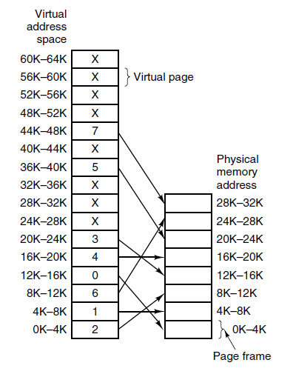
Figure : page table

Slide 42
Paging
When virtual memory is used, the virtual address is presented to an MMU (Memory Management Unit) that maps the virtual addresses onto the physical memory addresses.
A very simple example of how this mapping works is shown in next figure.
In this example, we have a computer generated 16-bit addresses, from 0 up to 64K.
  These are the virtual addresses.

Slide 43
Paging
  These are the virtual addresses.
  However, only 32 KB of physical memory is available, so although 64-KB programs can be written, they cannot be loaded in to memory in their entirety and run.
  A complete copy of a program’s core image, up to 64 KB, must be present on the disk. Only required pages are loaded in the physical memory.

Slide 44
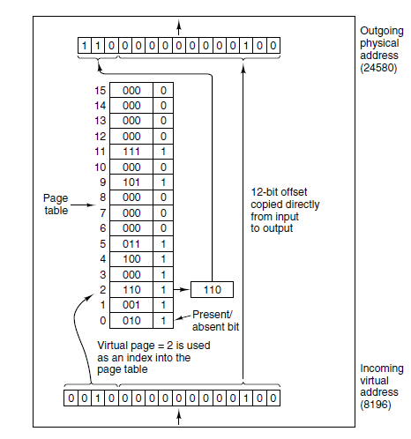
Figure :The internal
operation of the MMU
with 16 pages of 4-KB size.

Slide 45
Paging
  With
    64 KB of virtual address space
    32 KB of physical memory,
    4 - KB page size
    we get 16 virtual pages and 8 page frames.
  Transfers between RAM and disk are always in units of a page.

Slide 46
Paging
  The virtual address is split into
    virtual page number (high order bits) and
    offset (low-order bits).
  With a 16-bit address and a 4 - KB page size, the upper 4 bits could specify one of the 16 virtual pages and the lower 12 bits would then specify the byte offset (0 to 4095) within the selected page.

Slide 47
Paging
  The virtual page number is used as an index into the Page table.
  If the present/absent bit is 0, it is page-fault; a trap to the operating system is caused to bring required page into main memory.
If the present/absent bit is 1, required page is there with main memory and page frame number found in the page table is copied to the higher order bit of the output register along with the offset.
Together Page frame number and offset creates physical address.
Virtual Address = Page Number + offset
Physical Address = Page frame Number + offset of virtual address

Slide 48
Page Table

Slide 49
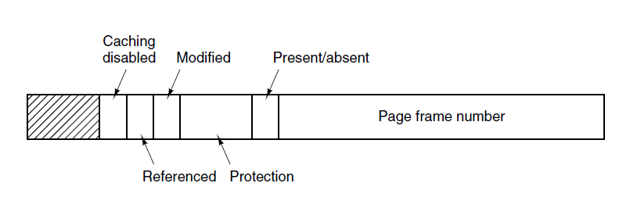
Structure of a Page Table Entry
Figure : A typical page table entry.

Slide 50
Page Table
  “Page table is a data structure which translates virtual address into equivalent physical address”.
  The virtual page number is used as an index into the Page table to find the entry for that virtual page and from the Page table physical page frame number is found.
  Thus the purpose of page table is to map virtual pages onto page frames.

Slide 51
  Typical fields of page table are
    Page frame number,
    Present / absent bit,
    Protection bits,
    Modified field,
    Referenced field,
    Cashing disabled field
    etc…

Slide 52
Page frame Number: This field shows the corresponding physical page frame number for a particular virtual page.
Present/Absent bit:
If this bit is 1, the entry is valid and can be used.
if this bit is 0, the virtual page to which the entry belongs is not currently in memory. Accessing page table entry with this bit set to 0 causes a page fault.
The Protection bits: This tells what kind of access is permitted.
If this bit is 1, page is read only.
If this bit is 0, page has read/write permission.

Slide 53
Modified bit:
- If this bit is 1, If the page in it has been modified (i.e., is ‘‘dirty’’),
it must be written back to the disk.
- If this bit is 0, If it has not been modified (i.e., is ‘‘clean’’),
it can just be neglected, since the disk copy is still valid.
- The bit is sometimes called the dirty bit, since it reflects the page’s state.
Referenced bit: A references bit is set whenever a page is referenced, either for reading or writing. Its value helps operating system in page replacement algorithm.

Slide 54
Cashing Disabled bit: With this bit cashing can be turned off.
If this bit is 1, then caching is turned off.
If this bit is 0, then caching is turned on.

Slide 55
Page Replacement
Algorithms
(Refer next ppt)

Slide 56
Speeding up
Paging

Slide 57
Speeding Up Paging
Major issues faced :
The mapping from virtual address to physical address must be fast.
If the virtual address space is large, the page table will be large.
Solutions :
Hardware TLB (Translation Lookaside Buffer)
Software TLB Management

Slide 58
TLB
Computer designers have observed that most programs tend to make a “large number of references to a small number of pages”.
Thus only a small fraction of the page table entries are heavily read; the rest are not frequently used.
TLB (Translation Lookaside Buffer)
“The solution that has been adopted is to equip computers with a small hardware device for mapping virtual addresses to physical addresses without going through the page table. Such device is called as TLB (Translation Lookaside Buffer)”

Slide 59
TLB
TLB is sometimes also called as an associative memory.
It is usually inside MMU and consists of a small number of entries, eight in this example, but rarely more than 256.

Slide 60
TLB
Each entry contains information about one page as follows :
  Virtual page number,
  Modified bit,
  Protection code (read/write/execute permissions),
  Physical page frame in which the page is located.
  These fields have a one-to-one correspondence with the fields in the page table, except for the virtual page number, which is not needed in the page table.
  Another bit indicates whether the entry is valid (i.e., in use) or not.

Slide 61
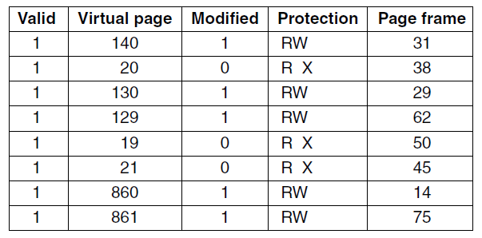
Translation Lookaside Buffers
Figure : TLB

Slide 62
TLB Function
if ( Requested virtual page number is present in the TLB)
{
The page frame is taken directly from the TLB
}
if ( Requested virtual page number is present in the TLB but instruction is trying to write on a read-only page)
{
a Protection Fault is generated
}

Slide 63
TLB Function
if ( Requested virtual page number is not present in the TLB)
{
The MMU detects the TLB miss.
It does an ordinary page table lookup.
It then replaces one of the entries from the TLB with the new page table entry just looked up.
Thus if that page is used again soon, the second time it will result in a TLB hit rather than a miss.
}

Slide 64
TLB Function
When a virtual address is presented to the MMU for translation, the hardware first checks to see if its virtual page number is present in the TLB, by comparing it to all the entries simultaneously (i.e., in parallel).
Doing so requires special hardware, which all MMUs with TLBs have.
If a valid match is found and the access does not violate the protection bits, the page frame is taken directly from the TLB, without going to the page table.
If the virtual page number is present in the TLB but the instruction is trying to write on a read-only page, a protection fault is generated.

Slide 65
TLB Function
The interesting case is what happens when the virtual page number is not in the TLB. The MMU detects the miss and does an ordinary page table lookup.
It then evicts one of the entries from the TLB and replaces it with the page table entry just looked up.
Thus if that page is used again soon, the second time it will result in a TLB hit rather than a miss.
When an entry is purged from the TLB, the modified bit is copied back into the page table entry in memory. The other values are already there, except the reference bit. When the TLB is loaded from the page table, all the fields are taken from memory.

Slide 66
Some additional Concepts:
1) Demand Paging
2) Pre paging
3) Locality of Reference
4) Working Set
5) Thrashing
6) Advantages and Disadvantages of Paging
7) Internal and External Fragmentation

Slide 67
1) Demand Paging
“The pages are loaded only on demand, not in advance”.
What happens if the virtual page number is not in the TLB.
  The MMU detects the miss and does an ordinary page table lookup.
  In the purest form of paging, processes are started up with none of their pages in memory.
  As soon as the CPU tries to fetch the first instruction, it gets a page fault, causing the operating system to bring in the page containing the first instruction.
  Other page faults for global variables and the stack usually follow quickly.

Slide 68
Demand Paging
  “After a while, the process has most of the pages it needs and settles down to run with relatively few page faults. This strategy is called demand paging because pages are loaded only on demand, not in advance.”

Slide 69
2) Pre paging
“Loading pages before allowing processes to run is called pre-paging”.
Many paging systems try to keep track of each process’s working set and make sure that it is in memory before letting the process run.

Slide 70
3) Locality Of Reference
locality of reference, also known as the principle of locality.
It is the phenomenon in which the same values, or related storage locations, are frequently accessed.
Locality is one type of predictable behaviour that occurs in computer systems. Systems that exhibit strong locality of reference are great candidates for performance optimization through the use of techniques such as the caching, perfecting for memory and advanced branch predictions at the pipelining stage of processor core.

Slide 71
Locality Of Reference
Depending on the memory access pattern, there are two basic types of reference locality:
  Temporal Locality
  Spatial locality.

Slide 72
a) Temporal Locality
Temporal locality refers to the reuse of specific data, and/or resources, within a relatively small time duration.
If at one point a particular memory location is referenced, then it is likely that the same location will be referenced again in the near future.
In this case efforts should be made to store a copy of the referenced data in special memory storage, which can be accessed faster.

Slide 73
b) Spatial Locality
If a particular storage location is referenced at a particular time, then it is likely that nearby memory locations will be referenced in the near future.
Spatial locality refers to the use of data elements within relatively close storage locations.
Sequential locality, a special case of spatial locality, occurs when data elements are arranged and accessed linearly, such as, traversing the elements in a one-dimensional array.
Notes:
In this case it is common to attempt to guess the size and shape of the area around the current reference for which it is worthwhile to prepare faster access.

Slide 74
4) Working Set
“The set of pages that a process is currently using is its working set”
If the entire working set is in memory, the process will run without causing many faults
If the available memory is too small to hold the entire working set, the process will cause many page faults and run slowly, since
  executing an instruction takes a few nanoseconds and
  reading in a page from the disk typically takes 10 msec .

Slide 75
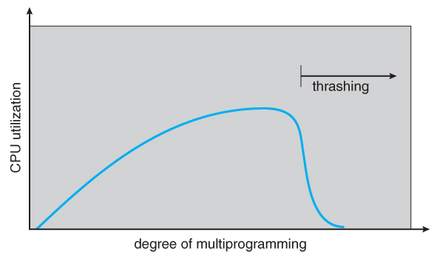
5) Thrashing
“A program causing page faults every few instructions is said to be thrashing”.

Slide 76
If a process doesn’t have “enough no. of Frames”, it will quickly generate a page fault. At this point it must replace pages.
However, all the page are in active use, it must replace a page that will be needed again right away.
Consequently it quickly faults again and again, replacing pages that it must bring back immediately.
This high paging activity is called as Thrashing.
“A process is thrashing if it is spending more time in page replacement than in executing”.

Slide 77
6) Advantages of Paging
Ability to load and execute a process that requires a larger amount of memory than what is available by loading the process in parts and then executing them.
No external fragmentation.
Efficient use of main memory.
Allows demand paging and prepaging.
More efficient swapping

Slide 78
Disadvantages of Paging
It tend to be slow and require additional support from the system's hardware for address translations.
Paging causes internal fragmentation – process may not use memory in exact multiples of pages. The last block allocated may not be completely full.
Ex. If a process is of size 10 KB and size of pages and page frames is 4KB then, 3 pages will be allocated as follows :
1st Page => 4KB Allocated => 4KB Used
2nd Page => 4KB Allocated => 4KB Used
3rd Page => 4KB Allocated => 2KB Used (Internal Fragmentation)

Slide 79
7) Internal and External Fragmentation
Internal Fragmentation :
“When memory allocated to a process is slightly larger than the requested memory, space at the end of a partition is unused and wasted. This wasted space within a partition is called as internal fragmentation”.
Paging Creates internal fragmentation.

Slide 80
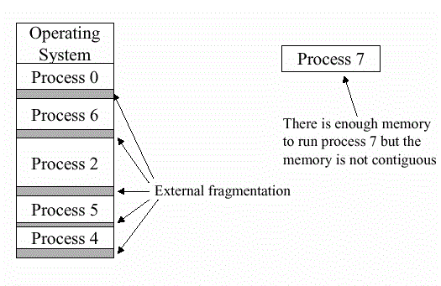
External Fragmentation :
“External fragmentation arises when free memory is scattered into small blocks and Total memory space is enough to satisfy a request (or to reside a process in it), but it is not contiguous so it can not be used”

Slide 81
Segmentation

Slide 82
Virtual memory is one-dimensional in nature because the virtual address space go from 0 to some maximum address, one address after another.
There are many problems where separate virtual address space for different entities(code, data, stack etc.) of process is much better.
A general solution is to provide the machine with many independent address spaces called segments.

Slide 83
“Logical address space of a process can be divided into blocks of varying size, called Segments”.
Each segment contains a logical unit of a process.
Logical unit can be main function, other function, procedure, stack, array, symbol table etc.
Each segment can be considered as a completely independent address space.

Slide 84
Each segment consists of a linear sequence of addresses, from 0 to the maximum allowed.
Different Segments may have different lengths.
Segment lengths may change during execution.
Different Segments can grow or shrink independently without affecting each other.

Slide 85
OS maintains Segment table which contains information about each segment of a process.
It contains Limit ( or size) and Base address of various segments.
Seg. No. | Limit | Base
0 | 1000 | 1200
1 | 500 | 4300
2 | 300 | 3000
3 | 800 | 3300
(a) Segment Table
To specify address in these segments the program must supply two part address:
    Segment number
    Offset (address within the segment.)

Slide 86
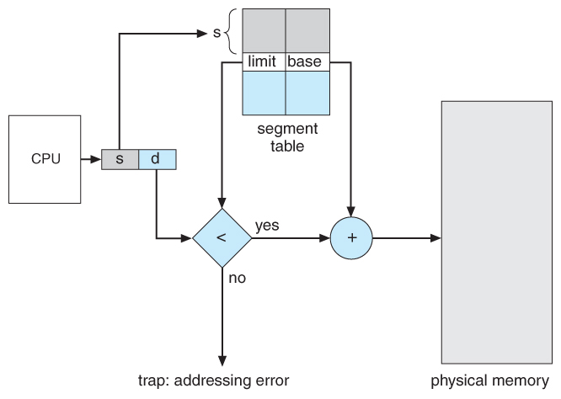
(b) Segment Implementation

Slide 87
Address Translation :
Example :
Logical Address = (2 , 125)
i.e. Segment = 2
Segment Limit = 300
Segment Base = 3000
Physical Address = Base + Offset
= 3000 + 125
= 3125

Slide 88
Advantages of Segmentation
All the segments are independent of each other, so each segment can grow and shrink without affecting other segments.
Sharing of procedures and data among various process is simple.
Different segments can be given different kind of protection, one can be read only while other can be writable and so on.
No internal fragmentation. Segments are given as much memory as required.

Slide 89
Disadvantages of Segmentation
It is expensive to allocate contiguous free memory to segments.
External fragmentation is possible which requires memory defragmentation or compaction.

Slide 90
Difference between
Paging and
Segmentation

Slide 91
Paging | Segmentation
1) Paging was invented to get large address space without having to buy more physical memory. | 1) Segmentation was invented to allow programs and data to be broken up into logically independent address space and to add sharing and protection.
2) Programmer does not know that it is implemented. | 2) The programmer is aware that segmentation is used.
3) Address space is one dimensional. | 3) Many independent address spaces are there.
4) Procedure and data cannot be protected separately. | 4) Procedure and data can be protected separately.
5) Change in data or procedure requires compiling entire program. | 5) Change in data or procedure requires compiling only affected segment not entire program.
6) Procedures cannot be shared between users. | 6) Procedures can be shared between users.
7) A page is of fixed size. | 7) A segment is of arbitrary size.
8) Paging causes internal fragmentation. | 8) Segmentation causes external fragmentation.

Slide 92
Reference Books:
    “Modern Operating Systems” by Andrew S Tanenbaum
    “Operating System Concepts” by Silberschatz, Peter B. Galvin and Greg Gagne

